Slide 1
Personal Finance
Personal Financial Statements
Gustavo Mota – Spring 2026

Slide 2

Agenda
Personal Financial Statements
Balance Sheet
Cashflow
Ratios
Budget

Slide 3


Why we need this?
To ensure that personal expenditure does not exceed income. You become more realistic on what you can afford and what you cannot.
To help start a savings plan, perhaps to save for a deposit on a property. Having control is the first step for further projections.
To work out how to afford a big budget item, such as a car or major holiday. Allows to stop dreaming and start planning.
To build up a reserve to cover expenses that may arise from unexpected future events
To pay off debts
In summary, in order to take action we need to become conscious first.
Notes:
FUNGIBILITY -

Slide 4
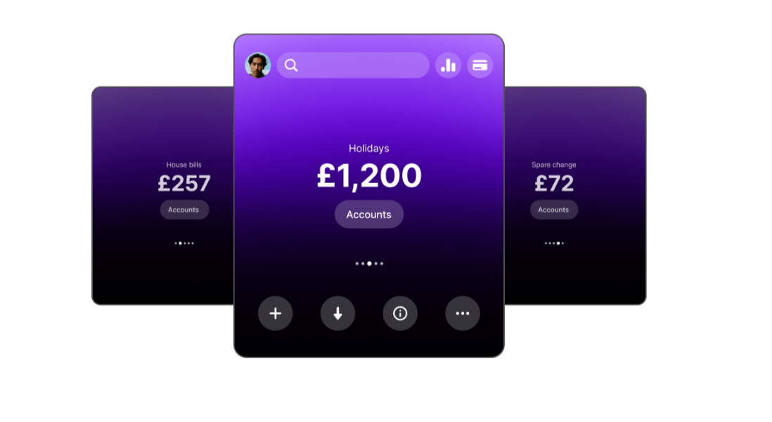
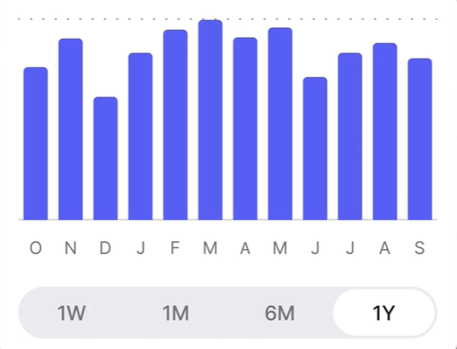
Sources of information
Payslips
Receipts
Readings from meters at home
Credit card statements
Bills
Bank statements
Revolut features

Slide 5
Balance Sheet
A balance sheet is a financial snapshot at a point in time.
It shows:
Assets (what you own)
Liabilities (what you owe)
Net Worth = Assets – Liabilities
Balance sheet is known to be a static measure (ie. As of Today)
Net worth can be positive or negative — negative is common early in life (student loans, mortgages). What matters is the trend.
Assets | € | Liabilities | €
Cash | 500 | Credit Card Balance | 300
Savings Account | 2,000 | Student Loan | 4,500
Laptop-Tech gadgets | 1,200
Car | 6,000 | Total Liabilities | 4,800
Total Assets | 9,700 | Net Worth | 4,900

Slide 6
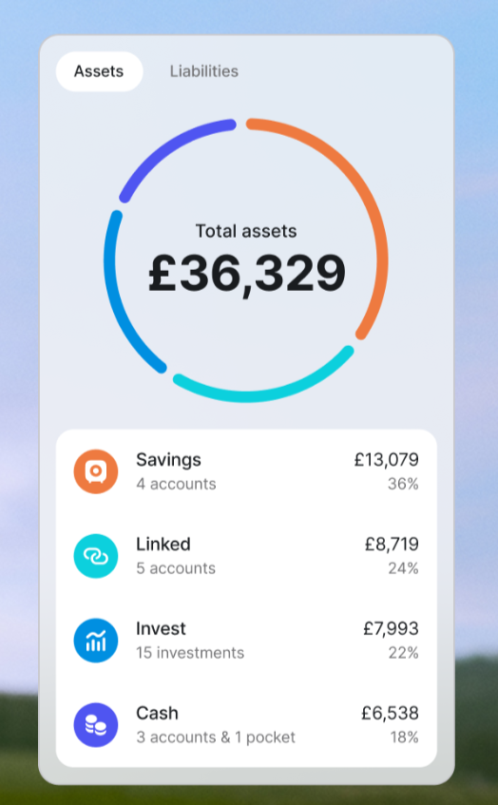
How to build it?
ASSSETS
Liquid assets are cash and items of value that can easily be converted to cash. Money in checking and savings accounts is liquid and is available to the Scott family for current spending. Money in bank accounts combined with other items of value are the foundation of your current financial position.
Real estate includes a home, a condominium, vacation property, or other buildings or land that a person or family owns.
Personal possessions are a major portion of assets for most people. Included in this category are automobiles and other personal belongings. Although these items have value, they may be difficult to convert to cash*.
Investment assets are funds set aside for long-term financial needs.
*Kapoor and others (2019) suggest to account under cost value. I suggest following a conservative accounting principle: the lowest of market value, or costs minus any depreciation

Slide 7
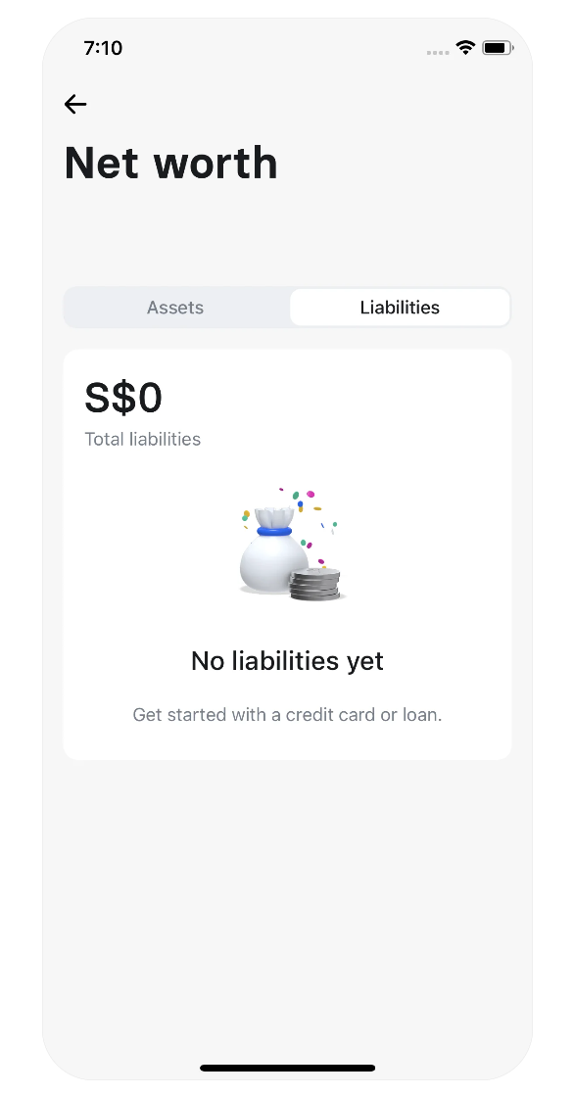
How to build it?
LIABILITIES
Current liabilities are debts you must pay within a short time, usually less than a year. These liabilities include such things as medical bills, tax payments, insurance premiums, cash loans, and credit card balances.
Long-term liabilities are debts you do not have to pay in full until more than a year from now. Common long-term liabilities include auto loans, educational loans, and mortgages.
*Kapoor and others (2019) suggest to account under cost value. I suggest following a conservative accounting principle: the lowest of market value, or costs minus any depreciation

Slide 8
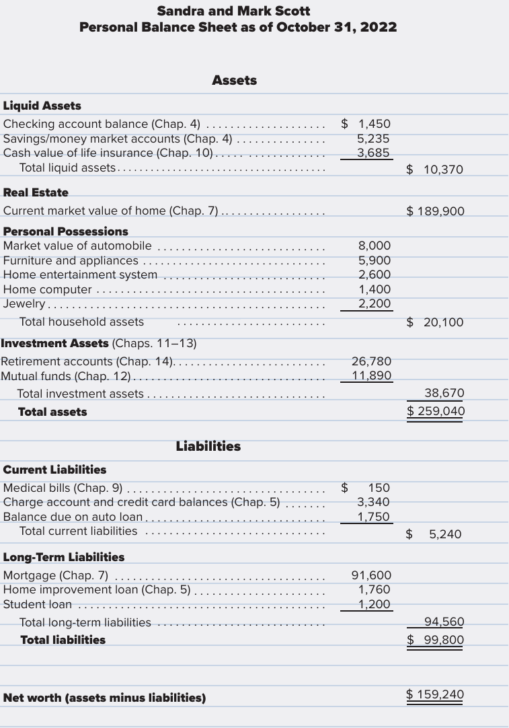
Example:

Slide 9
Using the Balance Sheet
Evaluate Liquidity:
  Liquidity ratio = Liquid Assets / Monthly Expenses.
Evaluate Solvency:
  Net Worth > 0?
  Debt to Assets = Total Liabilities / Total Assets.
  Track Over Time:
  Annual net worth statements show progress.
  Aim: net worth growth year over year.
A person may have a high net worth but still have financial difficulties. Having many assets with low liquidity means not having the cash available to pay current expenses. Insolvency is the inability to pay debts when they are due; it occurs when a person’s liabilities far exceed available assets.
Individuals and families can increase their net worth by (1) increasing their savings; (2) reducing spending; (3) increasing the value of investments and other possessions; and (4) reducing amounts owed.

Slide 10
Cash Flow Statement
A cash flow statement, also called a personal income and expenditure statement, is a summary of cash receipts and payments for a given period, such as a month or a year.
This report provides information on your income and spending patterns, which will be helpful when preparing a budget.
Most information can be found in your bank accounts.
Income | Amount (€) | Expenses | Amount (€)
Salary | 1,500 | Housing | 600
Dividends | 50 | Food | 250
Part-time | 200 | Services | 120
Total | 1,750 | Total | 970
Surplus = 780

Slide 11
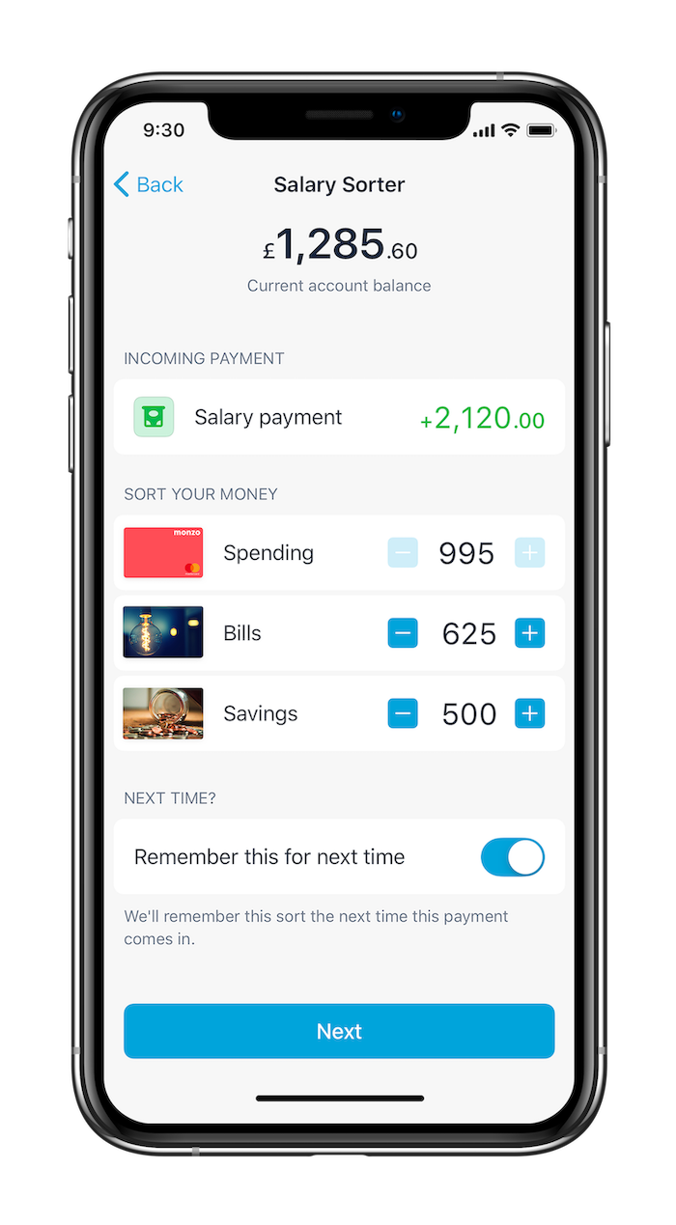
Why income management matters?
Sources of income
Income fuels saving, investing, and debt repayment
After-tax income—not gross—determines real choices
Align spending with objectives to avoid lifestyle creep
Automation and structure beat willpower
Active: wages, salaries, overtime, bonuses, freelance
Portfolio: dividends, interest, capital gains
Passive/Business: rental income, royalties, small business profits
Transfers: scholarships, benefits, pensions
Invest in human capital: education, certifications, high-ROI skills
Negotiate compensation: base, variable pay, equity, benefits
Build side income: freelancing, digital products, tutoring
Employ capital: diversified long-term investing

Slide 12
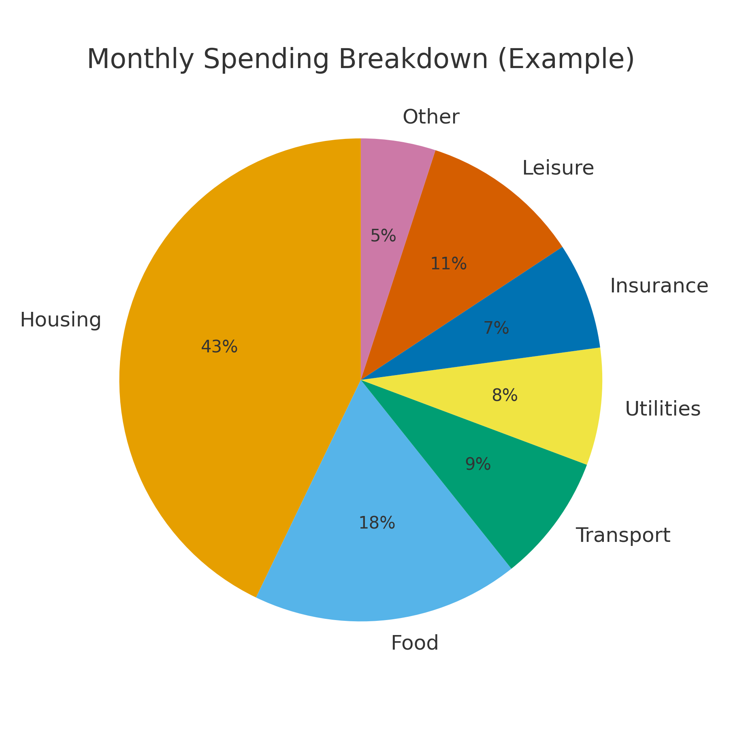
Expenditure categories and tips
Fixed: rent/mortgage, loans, insurance premiums
Variable: groceries, transport, utilities
Discretionary: leisure, dining out, subscriptions
Periodic/Irregular: repairs, tuition, annual fees (use sinking funds)
Track: bank export/app/spreadsheet
Structure: 50/30/20, envelope/zero-based budgeting
Squeeze leakage: subscription audit (status quo bias), impulse delay, category caps
Automate: bills, savings, and investing on payday

Slide 13
How to build it?
INCOME
Record all your money received. Income is the inflow or cash for an individual or household.
Salaries, self-employment, interest, dividends, gifts, grants, scholarships, government payments, pensions, retirement income, child support.
Take-home pay or net pay is the income after any deduction.
Discretionary income is what you have after paying for housing food and other necessities
OUTFLOWS
Record all the payments that you make during a period of time. You can classify them
Fixed expenses are payments that do not vary from month to month. Rent or mortgage payments, installment loan payments, wifi service, and a monthly train ticket for commuting to work are examples of constant or fixed cash outflows
Variable expenses are flexible payments that change from month to month. Common examples of variable cash outflows are food, utilities
A subset of variable expenses is discretionary expenses which include all the “wants” like leisure, gifts, etc.
The difference between inflows and out flows can be either a positive (surplus) or a negative (deficit) cash flow. When you have a cash surplus, this amount is available for saving, investing, or paying off debts.

Slide 14
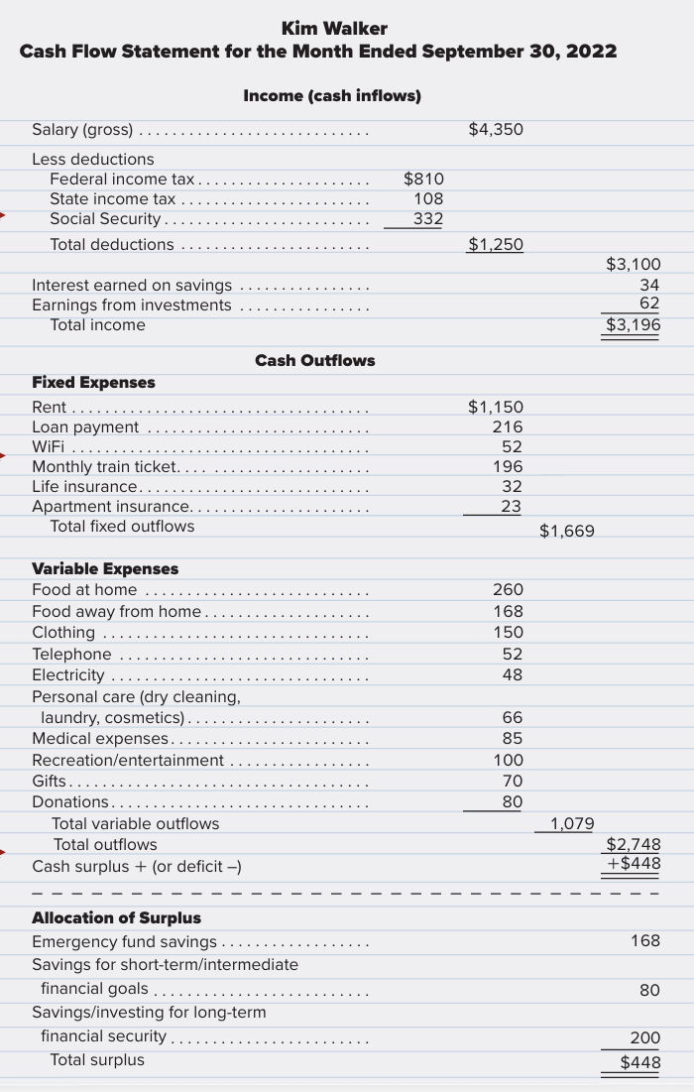
Example:

Slide 15
Ratios
Ratio | Calculation | Example | Interpretation
Debt ratio | Liabilities ÷ Net Worth | €25,000 ÷ €50,000 = 0.5 | Shows leverage: lower is better. A ratio >1 means liabilities exceed assets.
Current ratio | Liquid Assets ÷ Current Liabilities | €4,000 ÷ €2,000 = 2.0 | Indicates ability to pay short-term bills. Target ≥ 1.5–2.0.
Liquidity ratio | Liquid Assets ÷ Monthly Expenses | €10,000 ÷ €4,000 = 2.5 | Shows how many months you can cover expenses without income. Target: 3–6 months.
Debt-payment ratio | Monthly Credit Payments ÷ Take-home Pay | €540 ÷ €3,600 = 0.15 | Share of income spent on debt. Keep < 20%. Mortgage excluded.
Savings ratio | Monthly Savings ÷ Gross(or Net) Income | €648 ÷ €5,400 = 0.12 | Savings rate. Experts suggest 10–20% depending on life stage.
Net worth growth | (Net Worth this year – last year) ÷ last year | (€52,000–€50,000)/50,000=4% | Indicates wealth accumulation over time. Should be positive and consistent.

Slide 16
Budget
Category | Planned (€) | Actual (€)
Net Income | 1,800 | 1,820
Housing | 600 | 610
Food | 250 | 240
Transport | 120 | 130
Utilities | 110 | 95
Insurance | 100 | 100
Leisure | 150 | 170
Other | 70 | 60
Savings | 400 | 415
A budget, or spending plan, is necessary for successful financial planning. The common financial problems of overusing credit, lacking a regular savings program, and failing to plan for future financial security can be minimized through budgeting.
List net income sources (after tax)
List expenses by category (fixed, variable, discretionary)
Allocate targets (e.g., 50/30/20) and set category caps
Implement: accounts, automation, and routine tracking
Review monthly: actual vs plan; adjust caps and habits

Slide 17
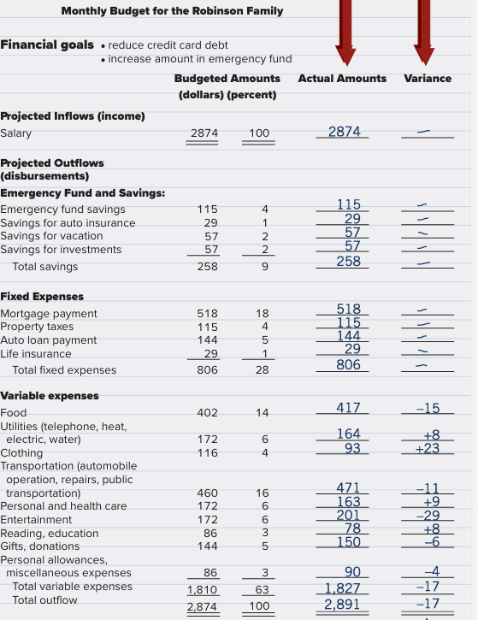
Example:

Slide 18
How to allocate?
Budget variance: The difference between the amount budgeted and the actual amount received or spent.
Deficit: The amount by which actual spending exceeds planned spending.
Surplus: The amount by which actual spending is less than planned spending.
There are many ways to decide your budget allocations.
Consider historical data: Usually fixed expenses are hard to change even if you wanted.
If you have flexibility then start by looking at your ratios: Are you comfortable with them? Then you can target (i.e. to turn savings ratio to 3)
If you are not sure, then use the 50/30/20 rule as a good anchor and adjust method

Slide 19
Thanks

